Slide 1
Mock Static Function
Developer Test
With MockCPP

Slide 2
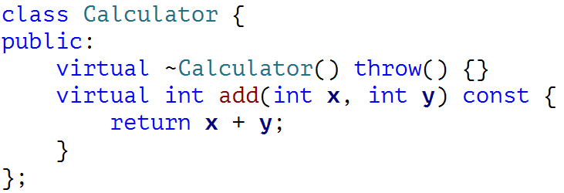
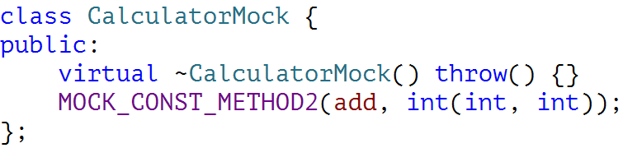
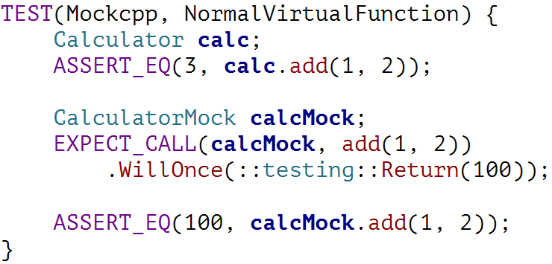
Mocking Virtual Functions
Virtual Functions

Slide 3
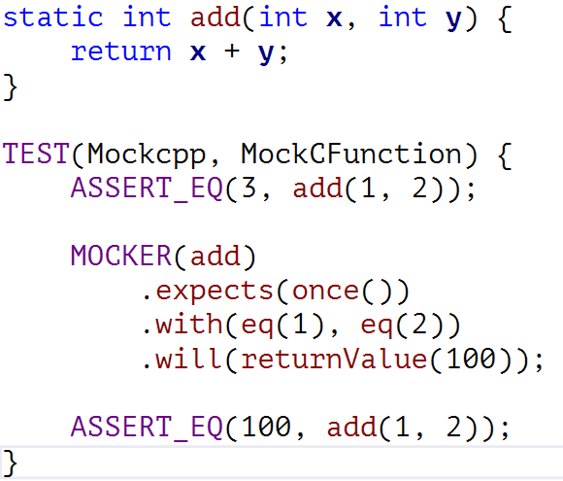
Mocking C Functions
Mockcpp Mocker

Slide 4
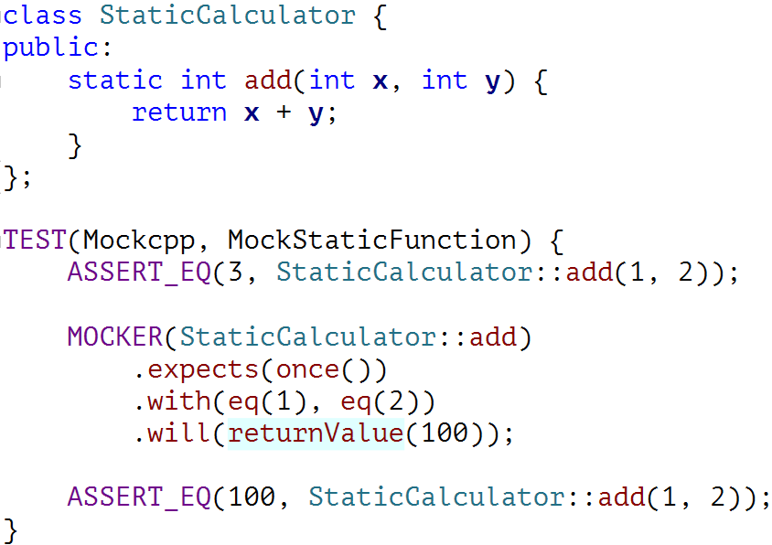
Mocking Static Functions
Mockcpp Mocker

Slide 5
Reference
https://code.google.com/p/mockcpp/

Slide 6
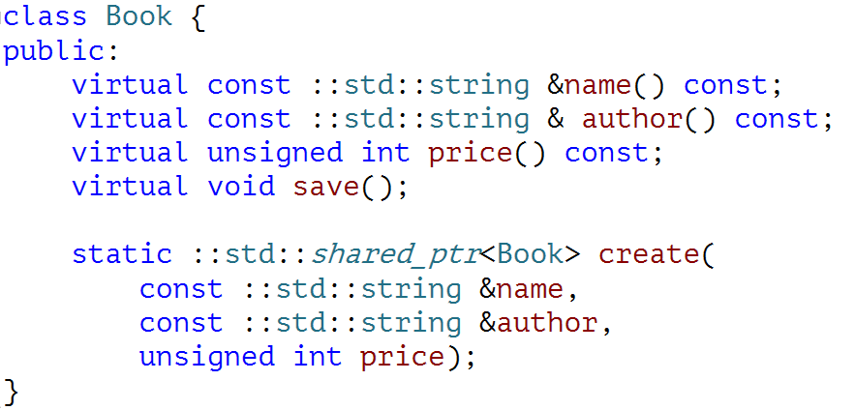
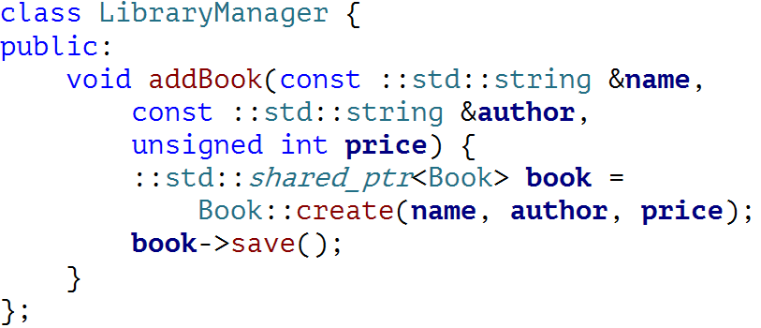
Practise
How to test it?

Slide 7
Update Local Repo
>git remote -v
>git remote add source http://github/DT.git
>git pull source master

Slide 8

Retro

Slide 9
THANK YOU
For questions or suggestions:
Wu Kun
kunwu@thoughtworks.com

